Slide 1
Collaborative Filtering
Generating film ratings
M2 BDMA
Decision Modelling
Fall 2023
Jose Antonio Lorencio Abril

Slide 2
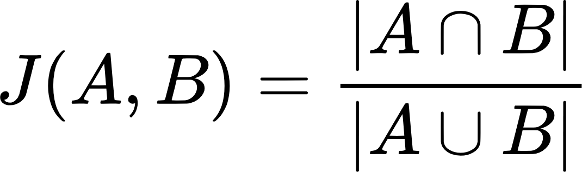
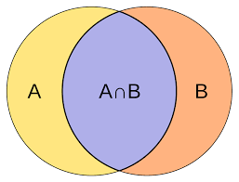
The 5th metric: Jaccard Similarity
Jaccard Similarity
Given two sets, A and B, their Jaccard index is

Slide 3
The 5th metric: Jaccard Similarity
Jaccard Similarity
Given two sets, A and B, their Jaccard index is
Problem:
Jaccard does not account for the ratings given by users
It only accounts for appearance or not

Slide 4
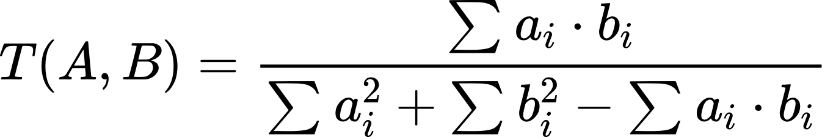
The 5th metric: Tanimoto Similarity
Tanimoto Similarity
Given two vectors, A and B, their Tanimoto index is
Tanimoto solves the Jaccard problem!

Slide 5
Generating Ratings
Generating random ratings
For i = 1:N_users
Generate user i
For j = 1:N_films
40% Chance: Not rated
60% Chance: Random rating between 1 and 5
The 40/60 chances increase the probability of having between 30-50% of blanks.

Slide 6
Generating Ratings
Generating valid random ratings
Repeat:
Generate a random rating R
Until 0.3 < blank_percentage(R) < 0.5 AND existsValidUser(R)
blank_percentage(R) returns the percentage of blanks in R
existsValidUser(R) returns whether there is a user with at least 50% blanks or not

Slide 7
All methods give the same recommendation
Generating a rating giving the same recommendation with all methods to a user
Repeat:
Generate valid ratings R
Get valid user from R, U
Compute recommendations for U
Until all recommendations coincide

Slide 8
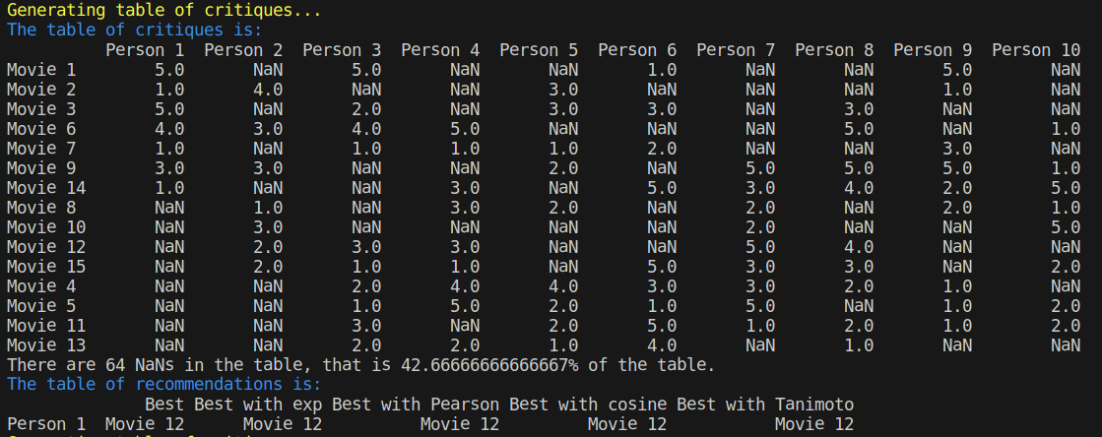
All methods give the same recommendation

Slide 9
Each method gives a different recommendation
Generating a rating giving different recommendations for each methods to a user
Repeat:
Generate valid ratings R
Get valid user from R, U
Compute recommendations for U
Until all recommendations differ

Slide 10
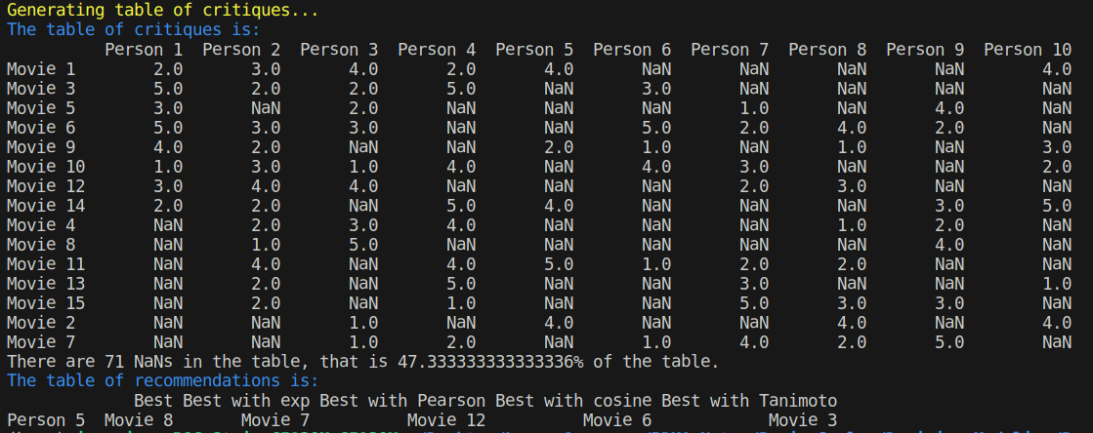
Each method gives a different recommendation

